Slide 1
INFO34049 Capstone Prototype Final Presentation
Sheridan College
Software Development & Network Engineering
5th Semester - 7th April 2022
Notes:
Hello Professor
Thank you for joining us to our capstone group presentation

Slide 2

OUR TEAM Group 37 – Polar Bears
Professor Vlodomir Voytenko
Danylo Perepelitsyn 991566760
Derya Kaya 991588609
Muharrem Kaya 991585597
Zawad Hossain 991583646
HEALTHY MEAL SERVICE
Notes:
Our Polar Bear group

Slide 3
AGENDA
01
02
03
04
05
06
Project Overview
Issues Faced
Technology in Action
Project description
- Zawad
Complication encountered - Zawad
Softwares and Tools been used - Derya
Inside HMS
Outside HMS
Future Implementation
Tech behind HMS
DB, Firebase - Muharrem
UI of the application - Muharrem
6th Semester work
– Daniel
Notes:
This is the Agenda for today and we have Daniel with us today hopefully he will have a stable connection

Slide 4
01
PROJECT OVERVIEW
Notes:
Project overview

Slide 5

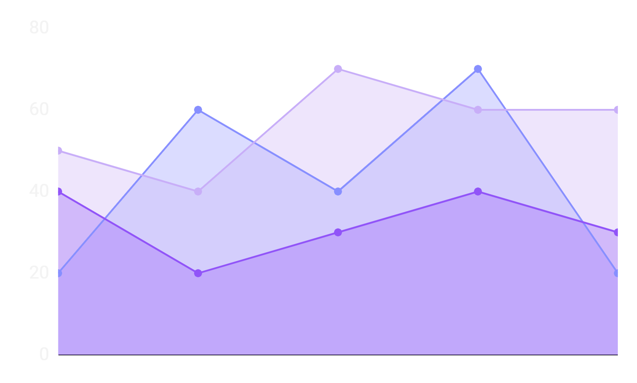
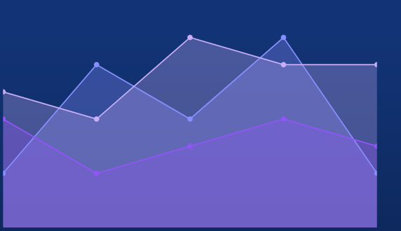
TRENDS
Unhealthy choices – Fastfood, packaged food consumption
Your Health – becoming unhealthy over the years
Healthy cooked meal – Demand is there but costly
An illustration showing the trend of the health against choice of food
Notes:
Showing the trend of making choices when it comes to food and health
How our quality of health drops as we make unhealthy choices

Slide 6
PROBLEM VS SOLUTION
PROBLEM
SOLUTION
Due to convenience people are priorotizing their taste buds over the health
A meal delivery service which will deliver healthy meal at your door steps
Notes:
The problem our health is detoriating
Solution to come up with a meal service provide healthy meal

Slide 7
Healthy Meal Service
A service that ensures you a healthy life by addressing your needs
Notes:
What is healthy meal service
It’s a service which addresses your needs and prioritize your health by delivering healthy meals at your doorsteps

Slide 8
COMPETITORS
Uber
Doordash
Other meal services
Global pioneer in the meal delivery service
A competitor to Uber
There are currently over 85 meal service companies in Ontario
Notes:
The giants in the current market

Slide 9
THEM VS US
THEM
US
They don’t take your health into consideration
We have an in-house nutritionist to take care of you
Notes:
The difference is that we are planning to have an inhouse nutritionist

Slide 10
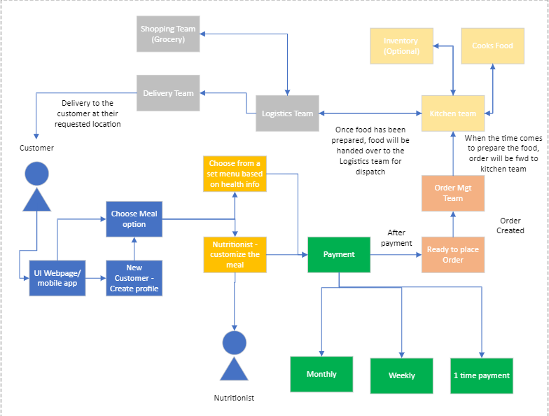
HMS – Proposed System Flow
Notes:
This is our proposed system

Slide 11
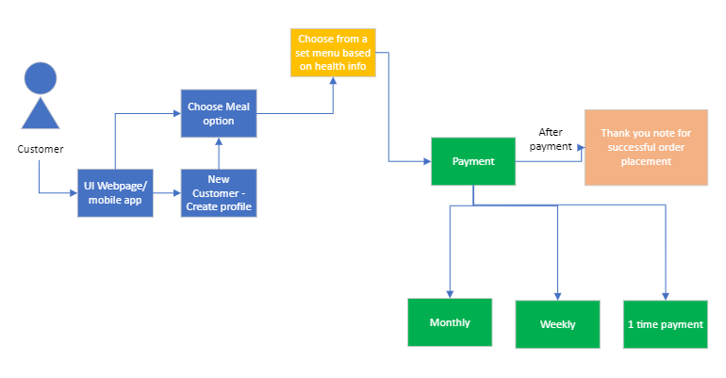
HMS – Current System Flow
Notes:
And for this semester
We are hoping to achieve this

Slide 12
02
ISSUES FACED
Notes:
Now moving to issues we faced

Slide 13
ISSUES FACED
All projects encounters problems, we had ours
Finalizing the project
On going war
Being remote
Re-designing DB schema
Re-doing UI
Payment gateway
We held tight and planned for the future!
Notes:
Like other projects we did face some issues

Slide 14
03
TECHNOLOGY IN ACTION
Notes:
Now Derya will talk about the tools and tech we used in the project so far

Slide 15
DEVELOPMENT TOOLS
ECLIPSE
VISUAL PARADIGM
Coding in Java and Springframework to create the back end
For creating use-cases, DB Schema and class diagram
XCODE
JENKINS
To create the UI of the mobile application in iOS platform
For testing out our project
And other tools

Slide 16
COLLABORATION TOOLS
GITHUB
Our project repository
MS TEAMS
For our weekly meetings
OneDrive
Sharing files with members
Monday.com
Our WBS for the project

Slide 17
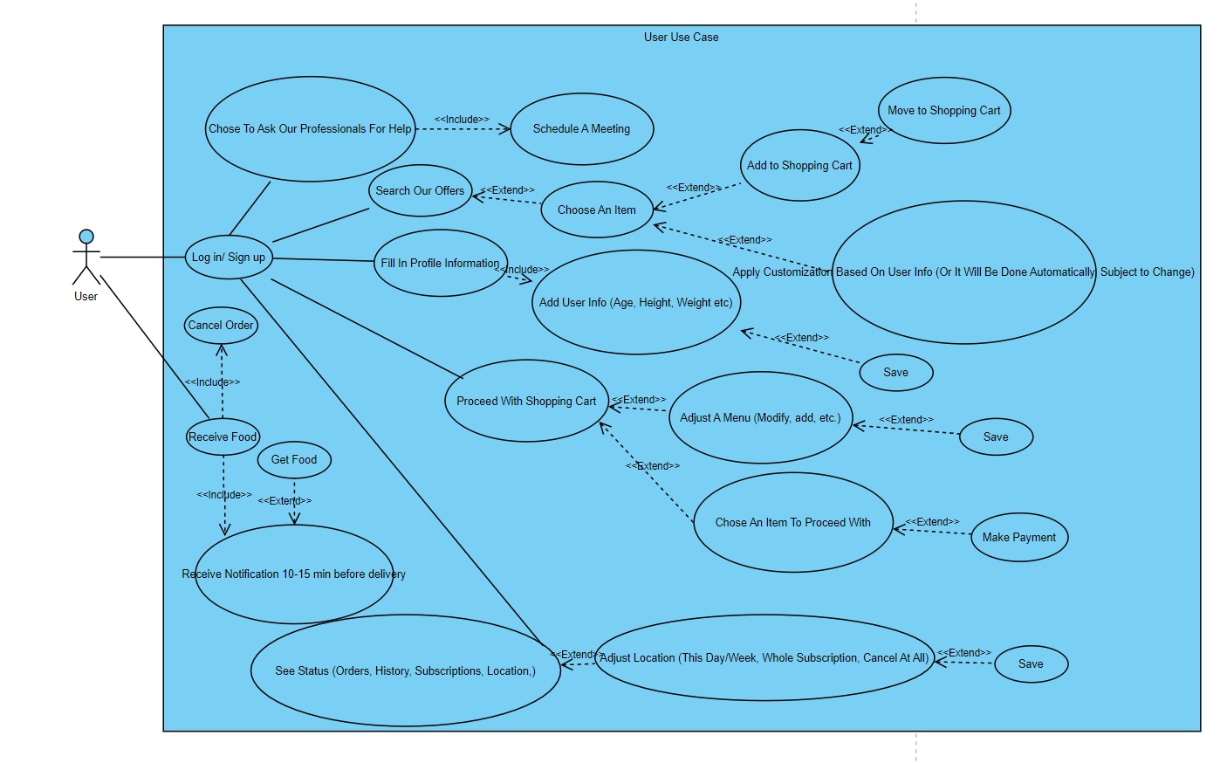
USE CASES - USER

Slide 18
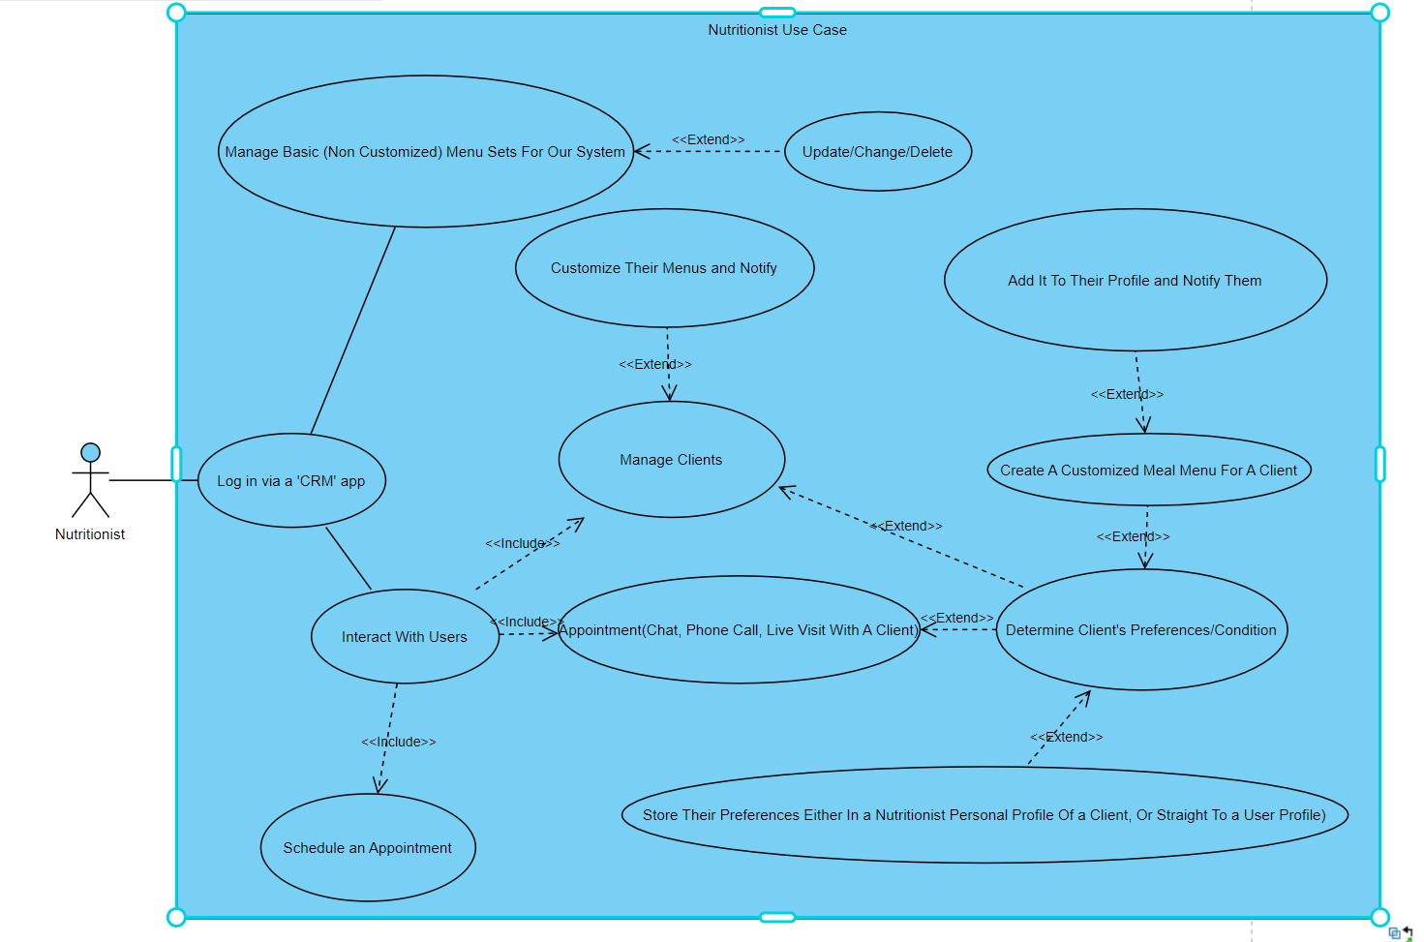
USE CASES - NUTRITION

Slide 19
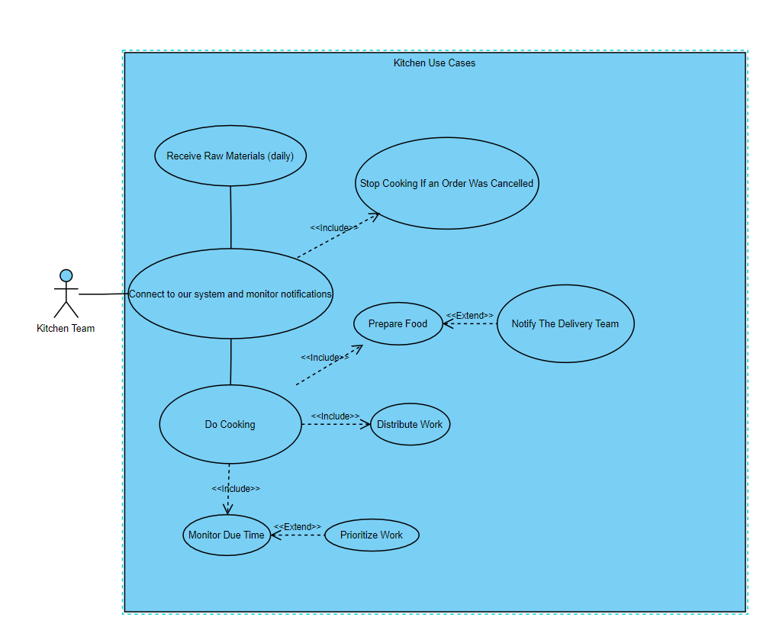
USE CASES - KITCHEN

Slide 20
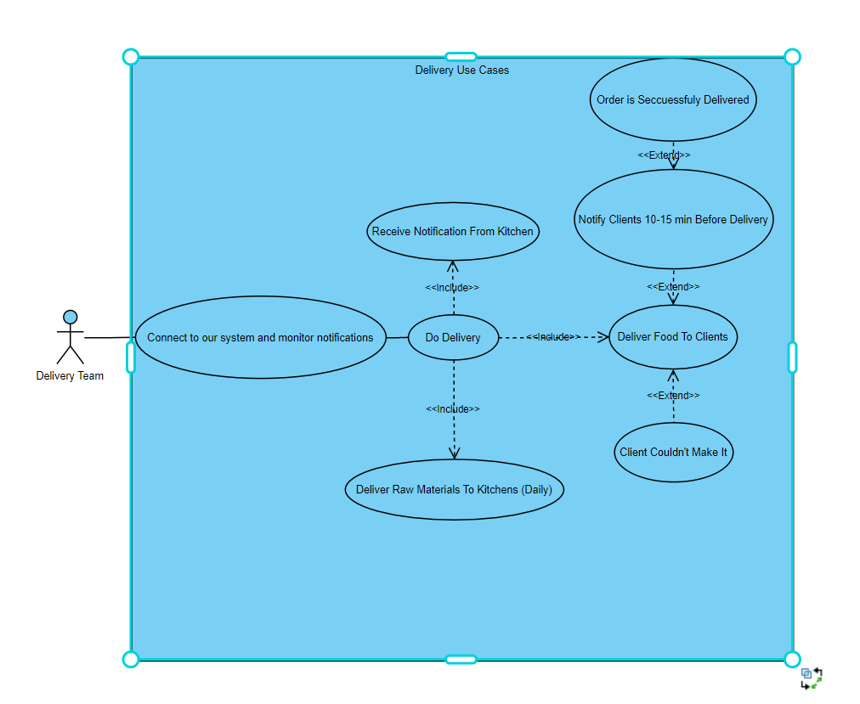
USE CASES - DELIVERY

Slide 21
04
INSIDE HMS

Slide 22
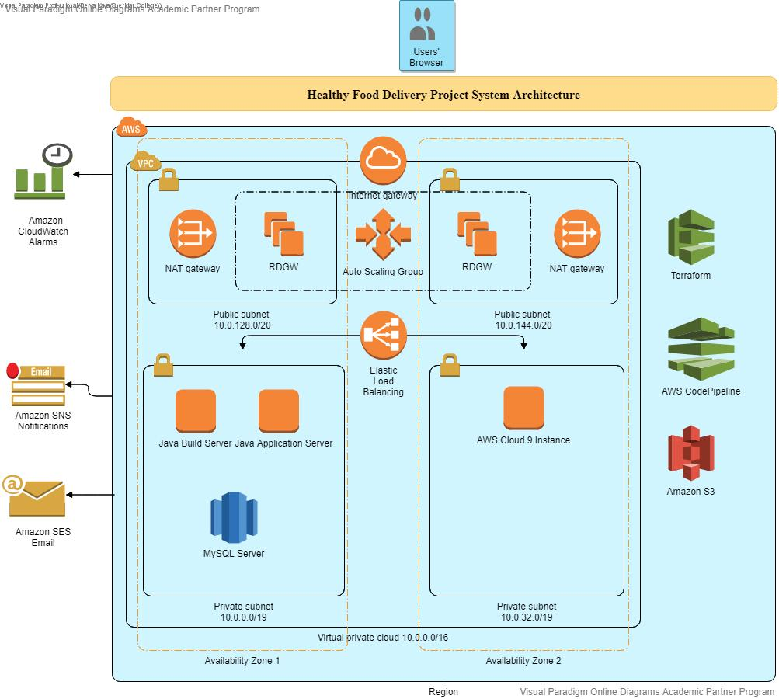
COMPATIBILITY & SYS-NET ARCHITECTURE DIAGRAM

Slide 23
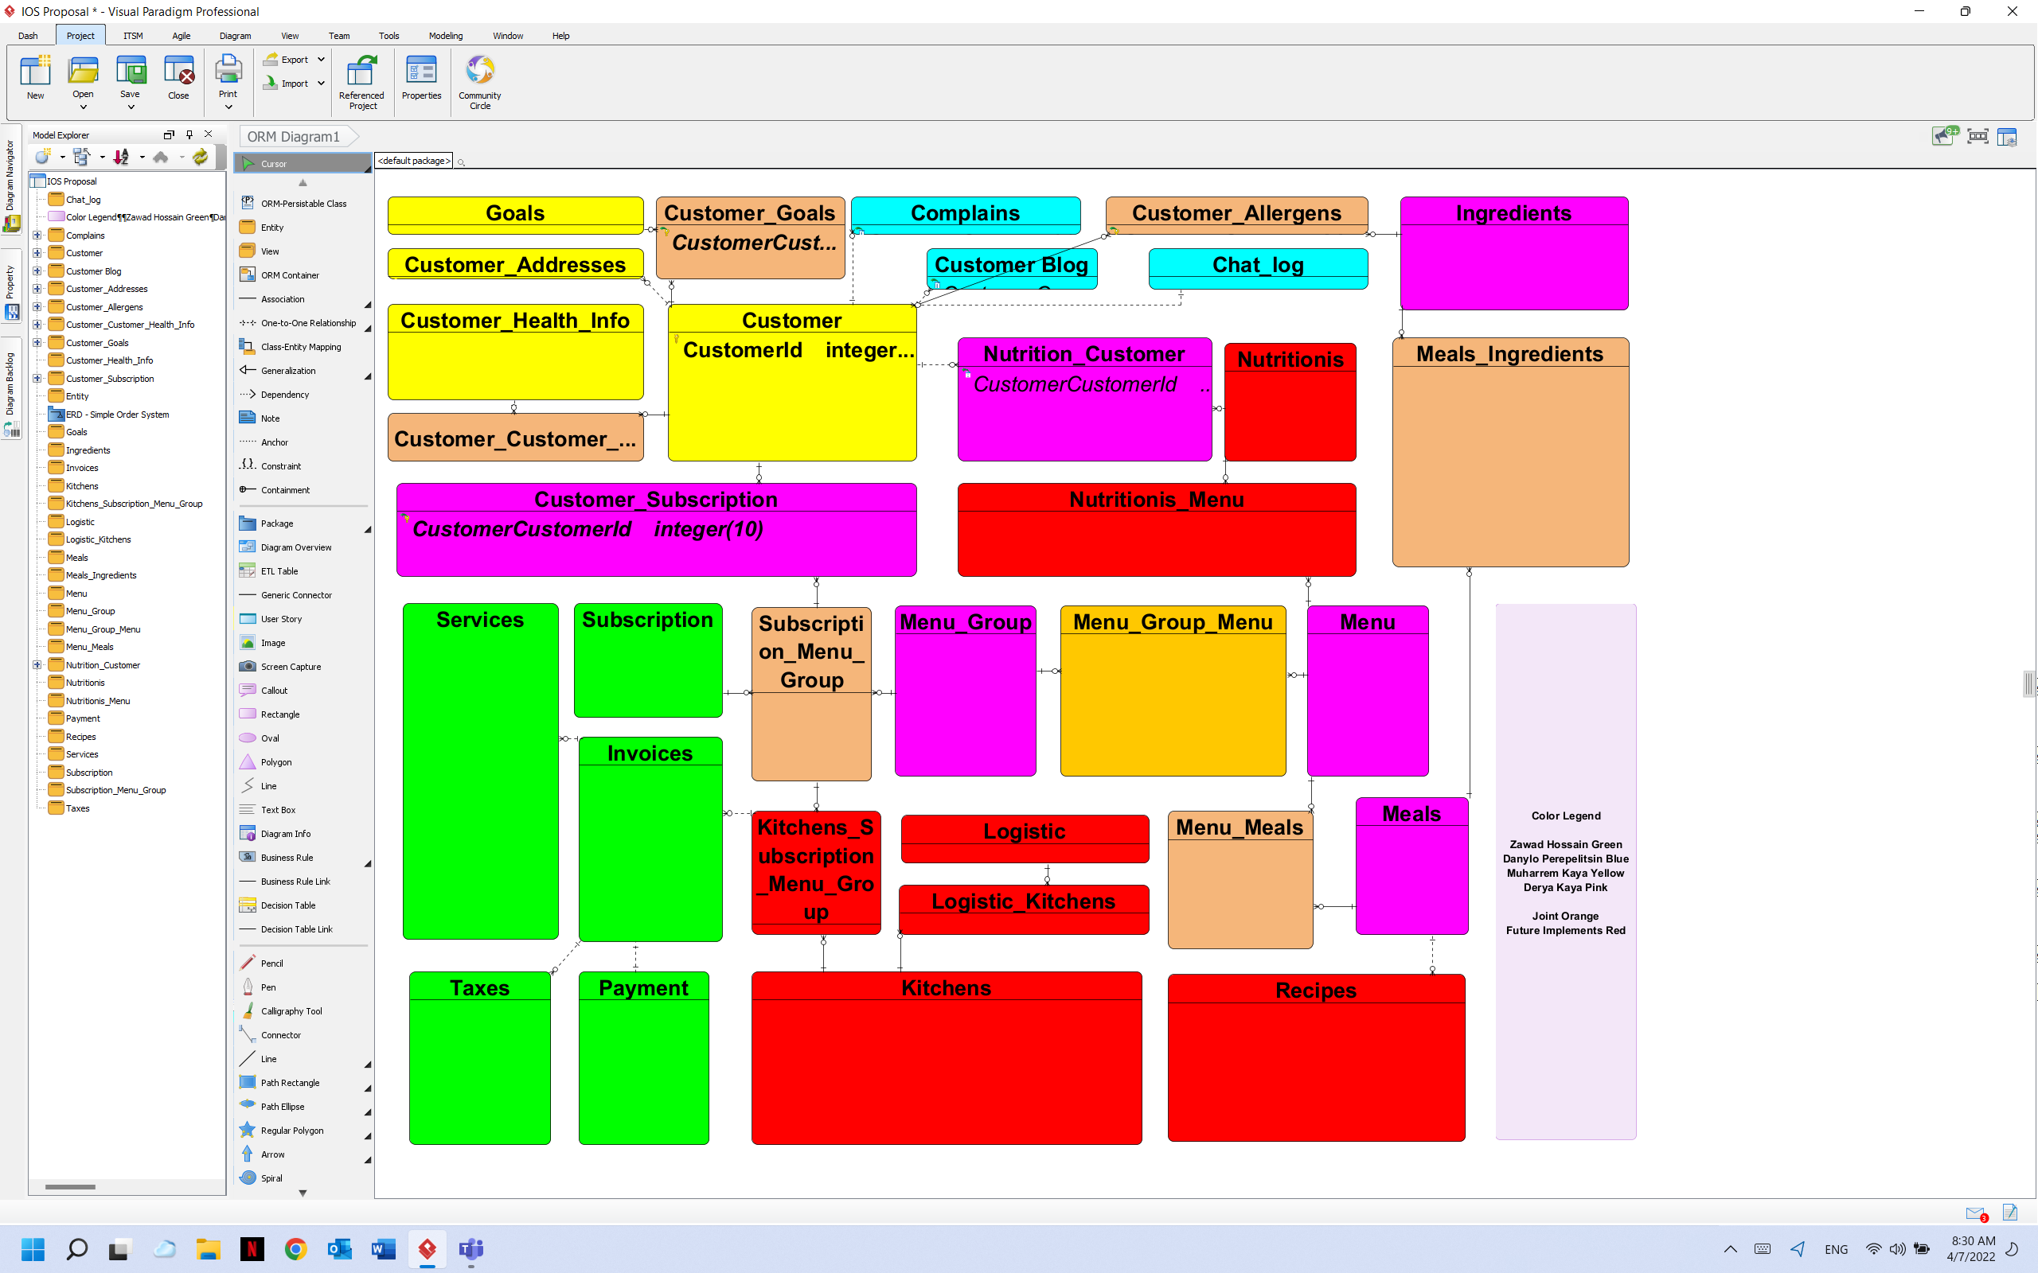
ORM – OBJECT RELATIONAL MAPPING

Slide 24
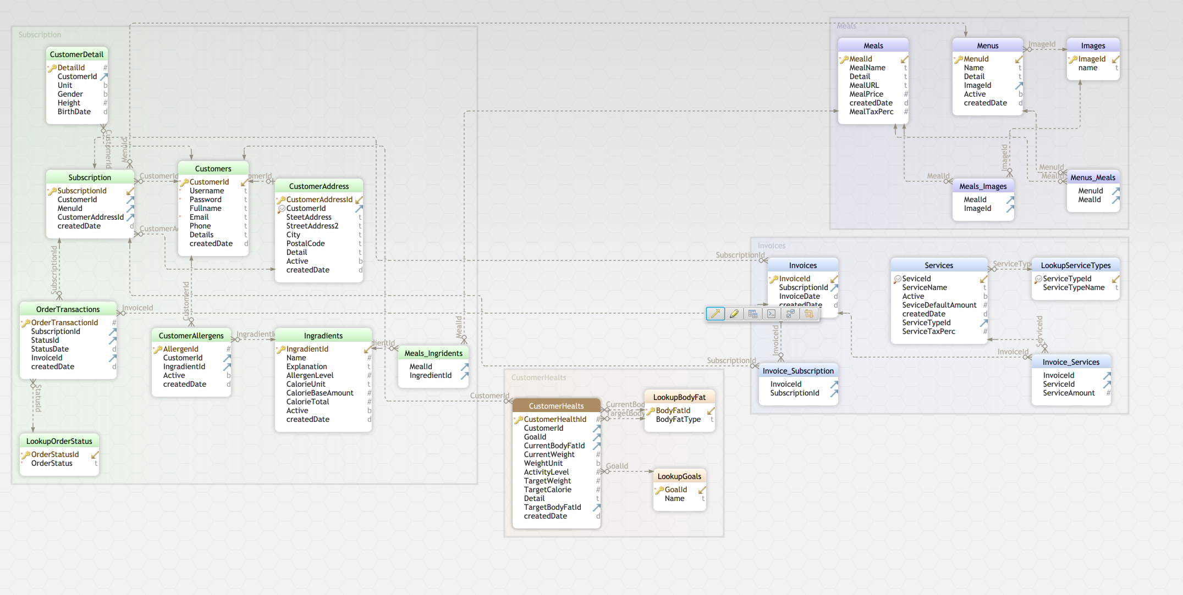
ERM – ENTITY RELATIONSHIP MODEL

Slide 25
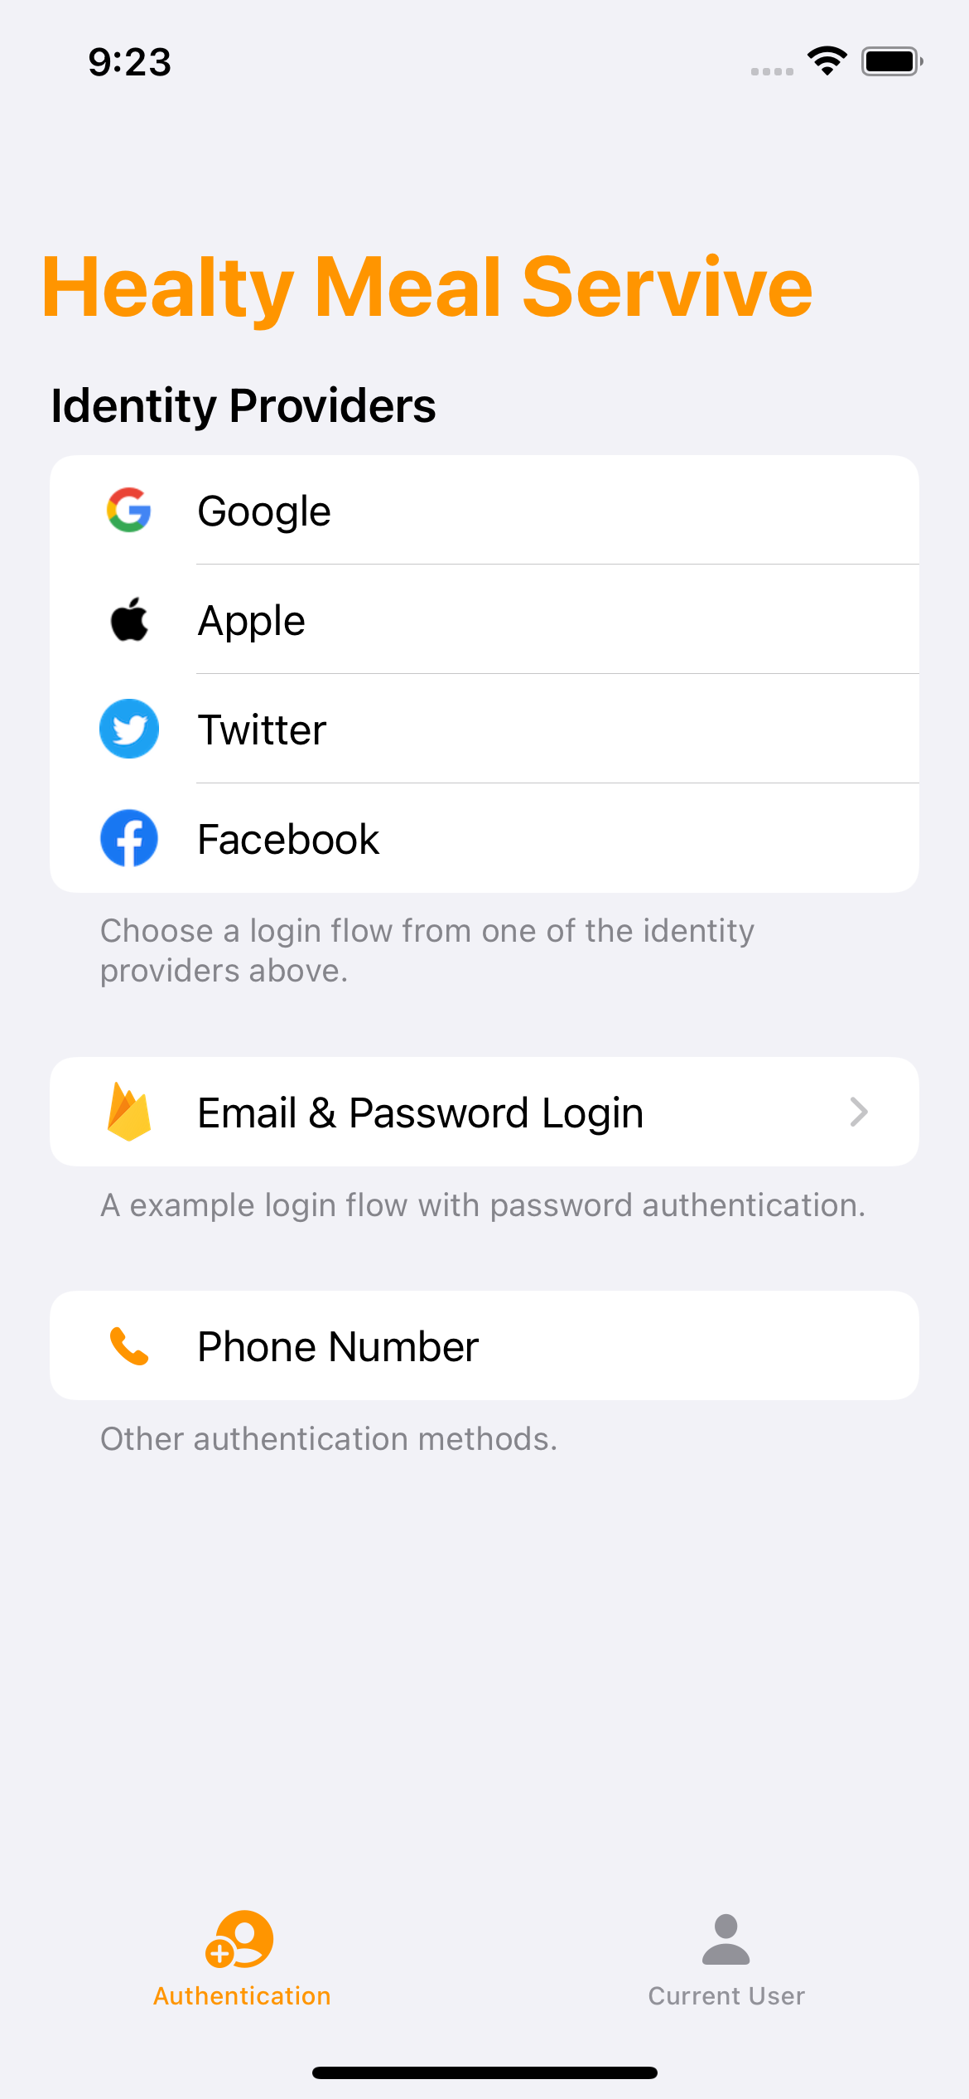
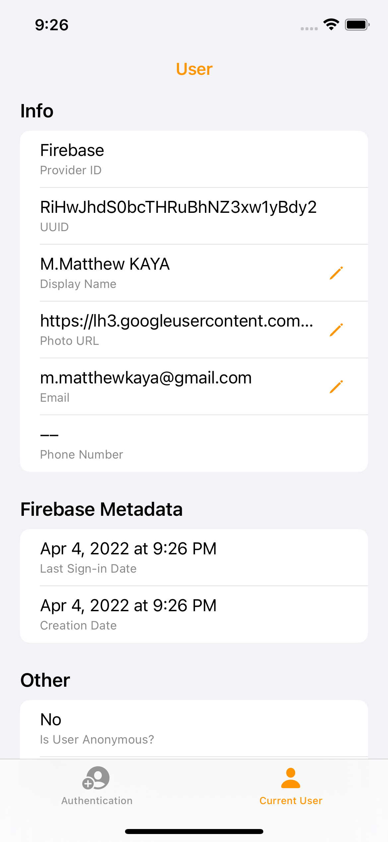
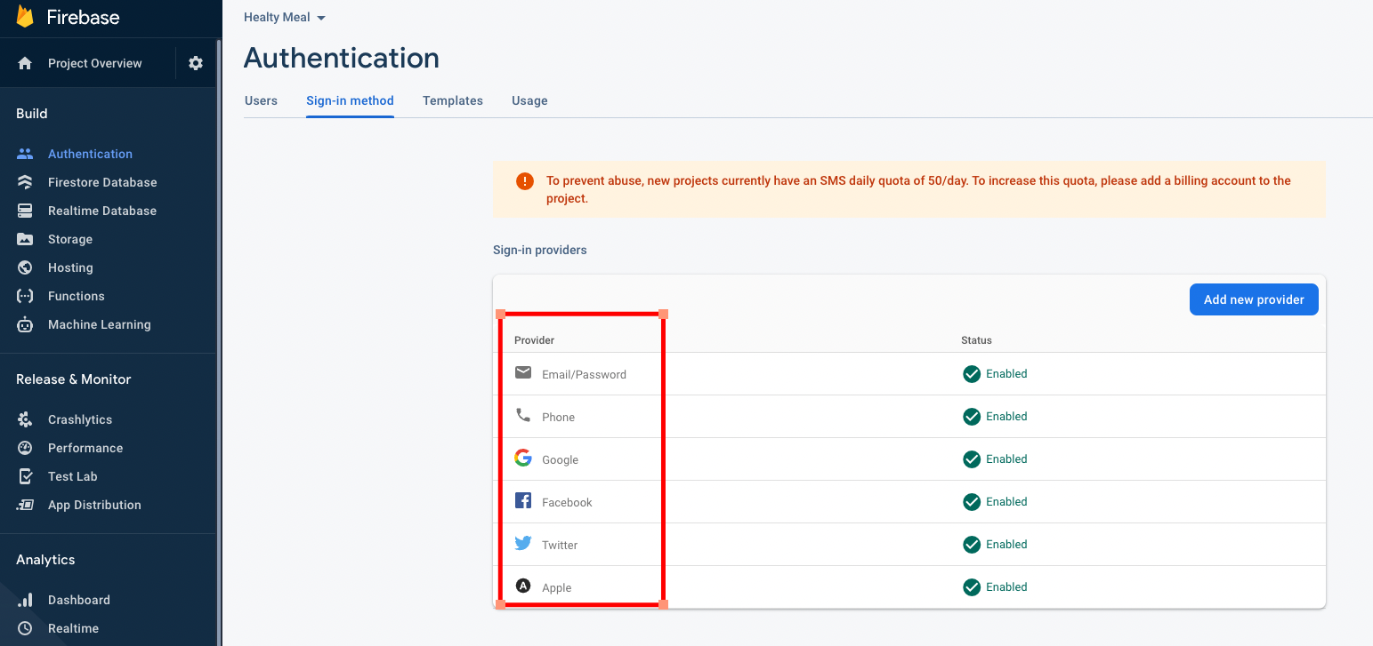
FIREBASE – USER AUTHENTICATION
LOGIN & LOGIN INFO
FIREBASE DASHBOARD

Slide 26
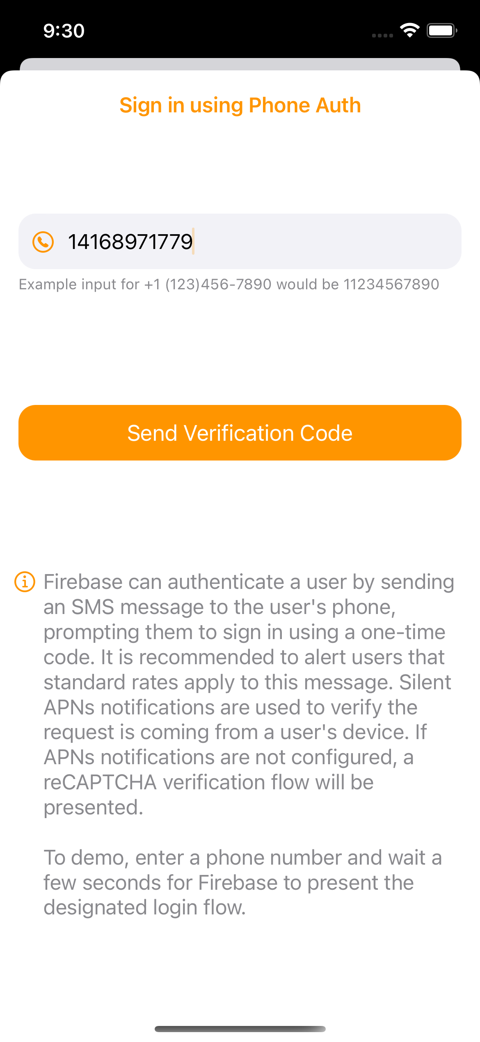
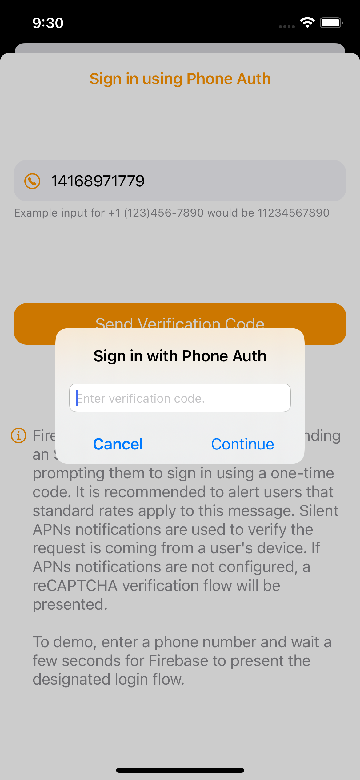
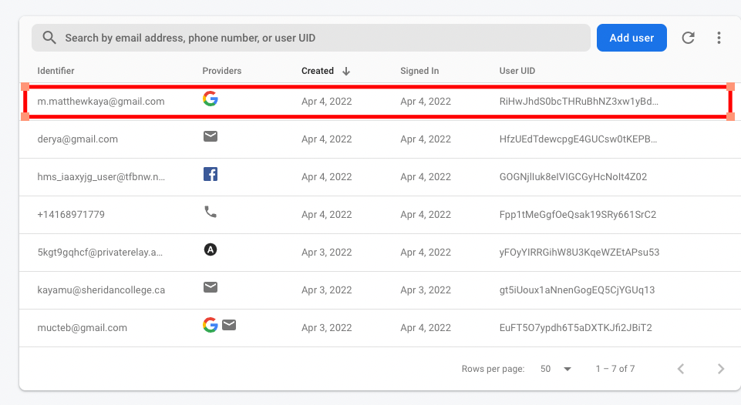
FIREBASE – USER AUTHENTICATION
SIGN IN AUTHENTICATION
FIREBASE USER ACCOUNTS

Slide 27
05
OUTSIDE HMS

Slide 28
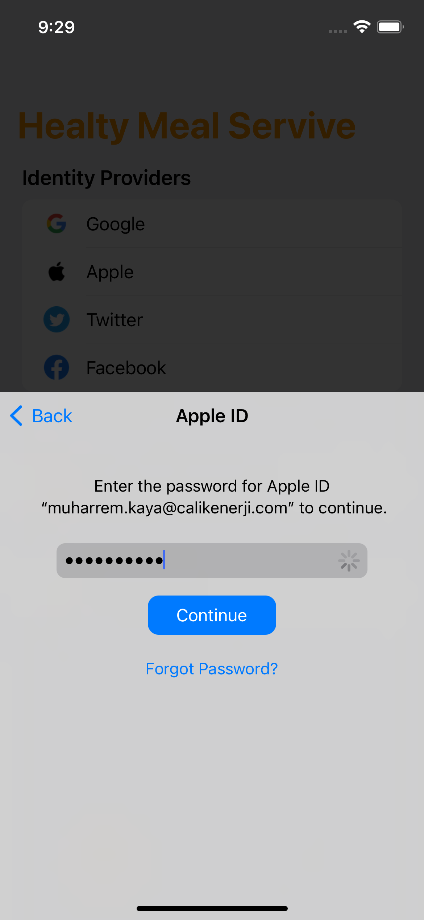
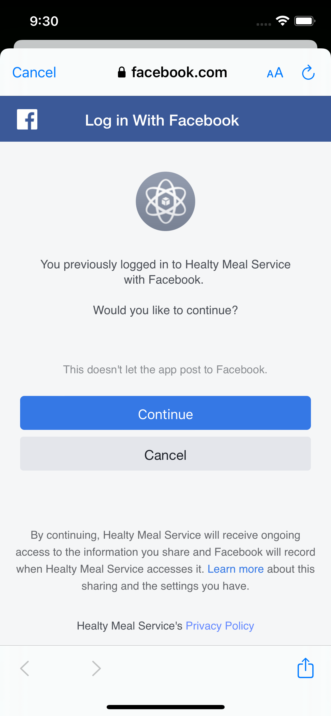
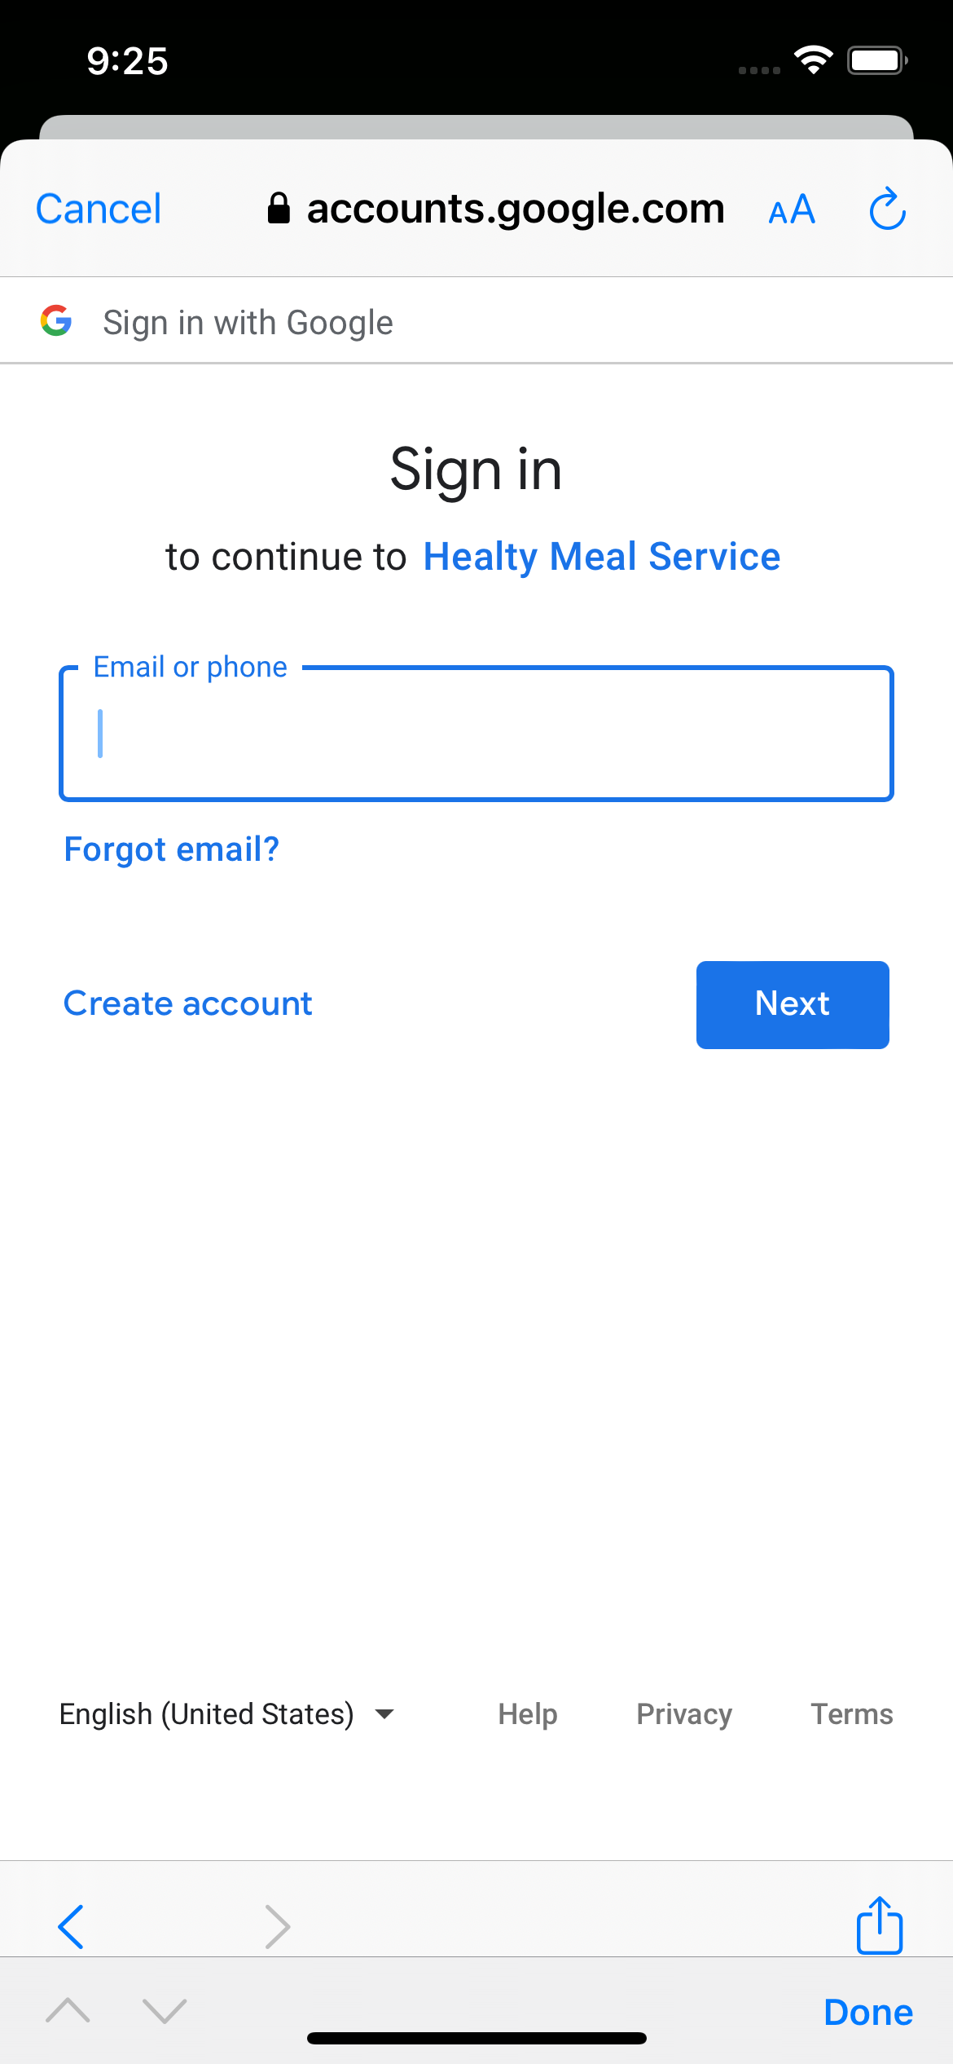
USER INTERFACE - REDESIGN
Customer Login
Login Options

Slide 29
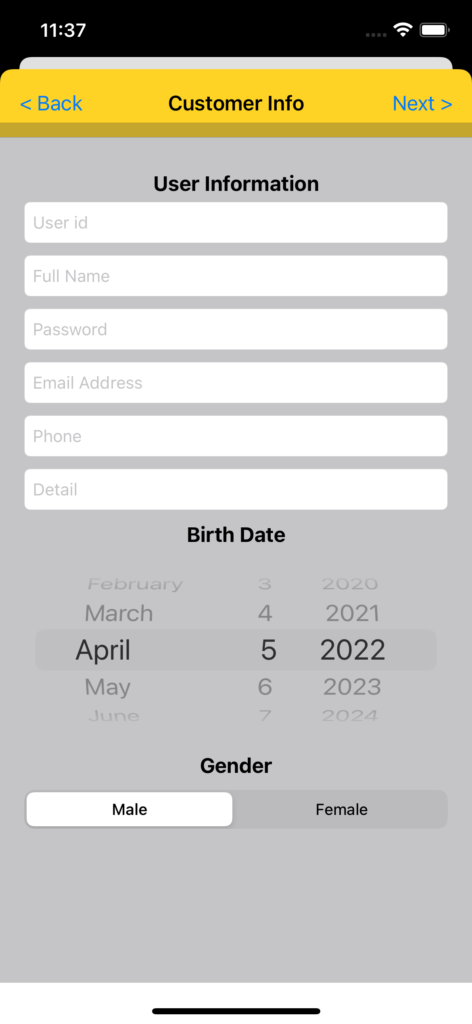
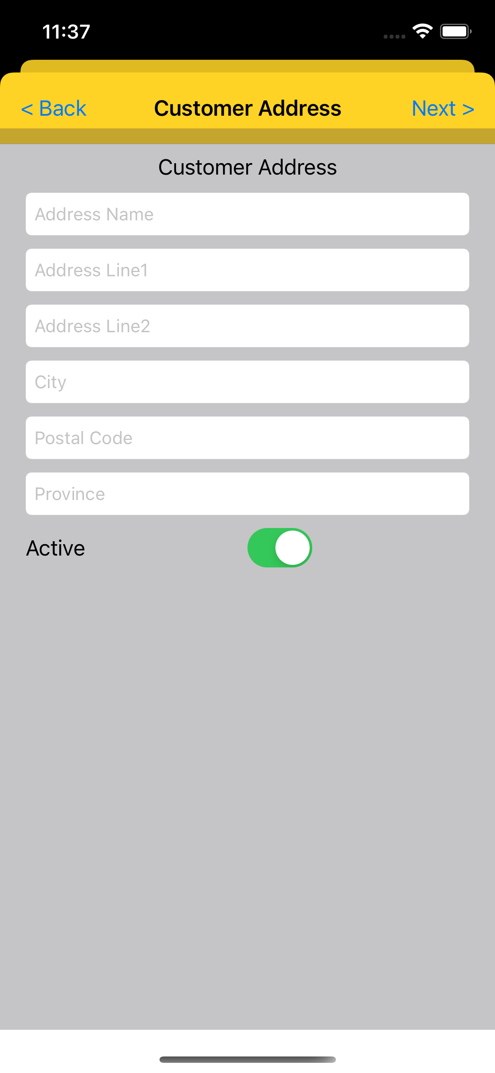
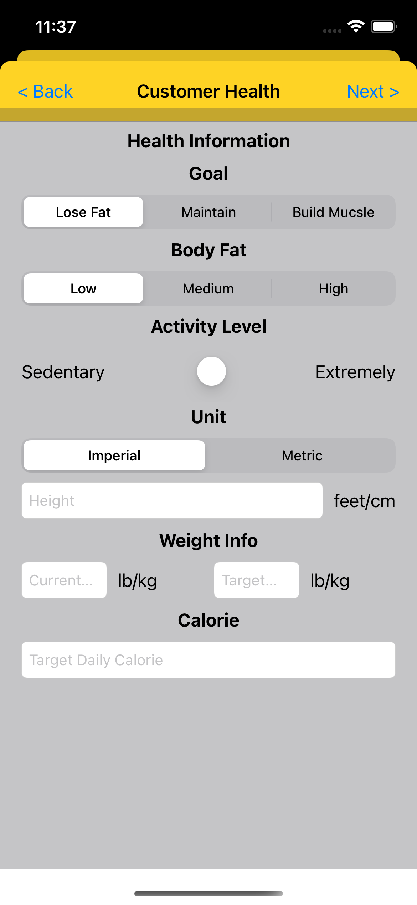
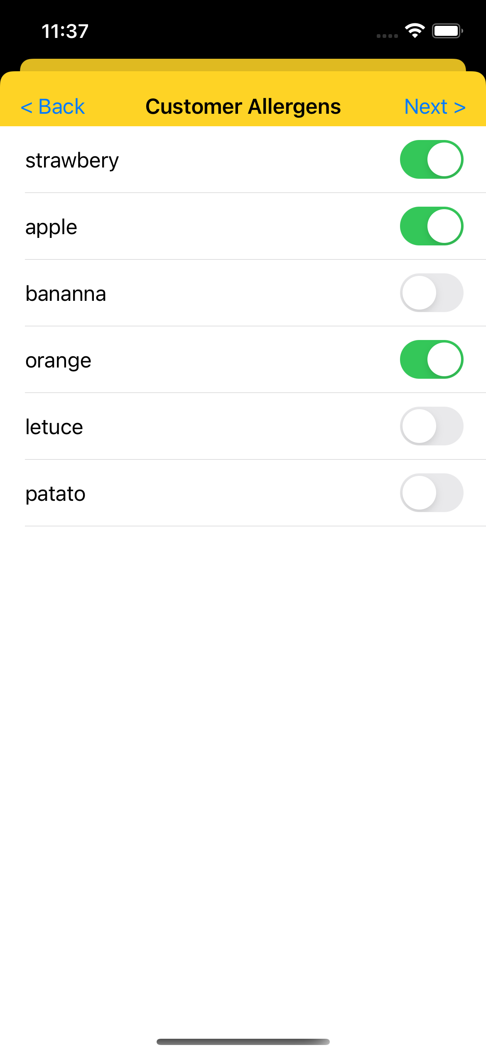
USER INTERFACE - REDESIGN
Customer General
Customer Health Info

Slide 30
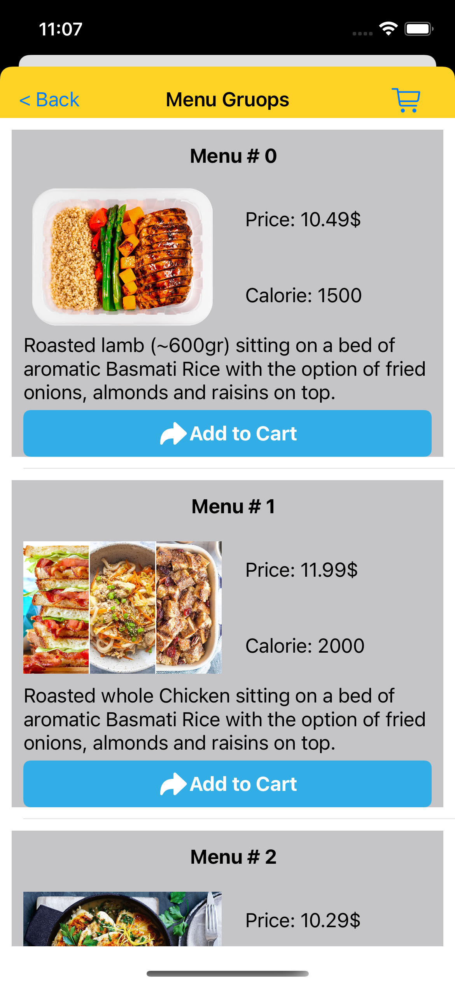
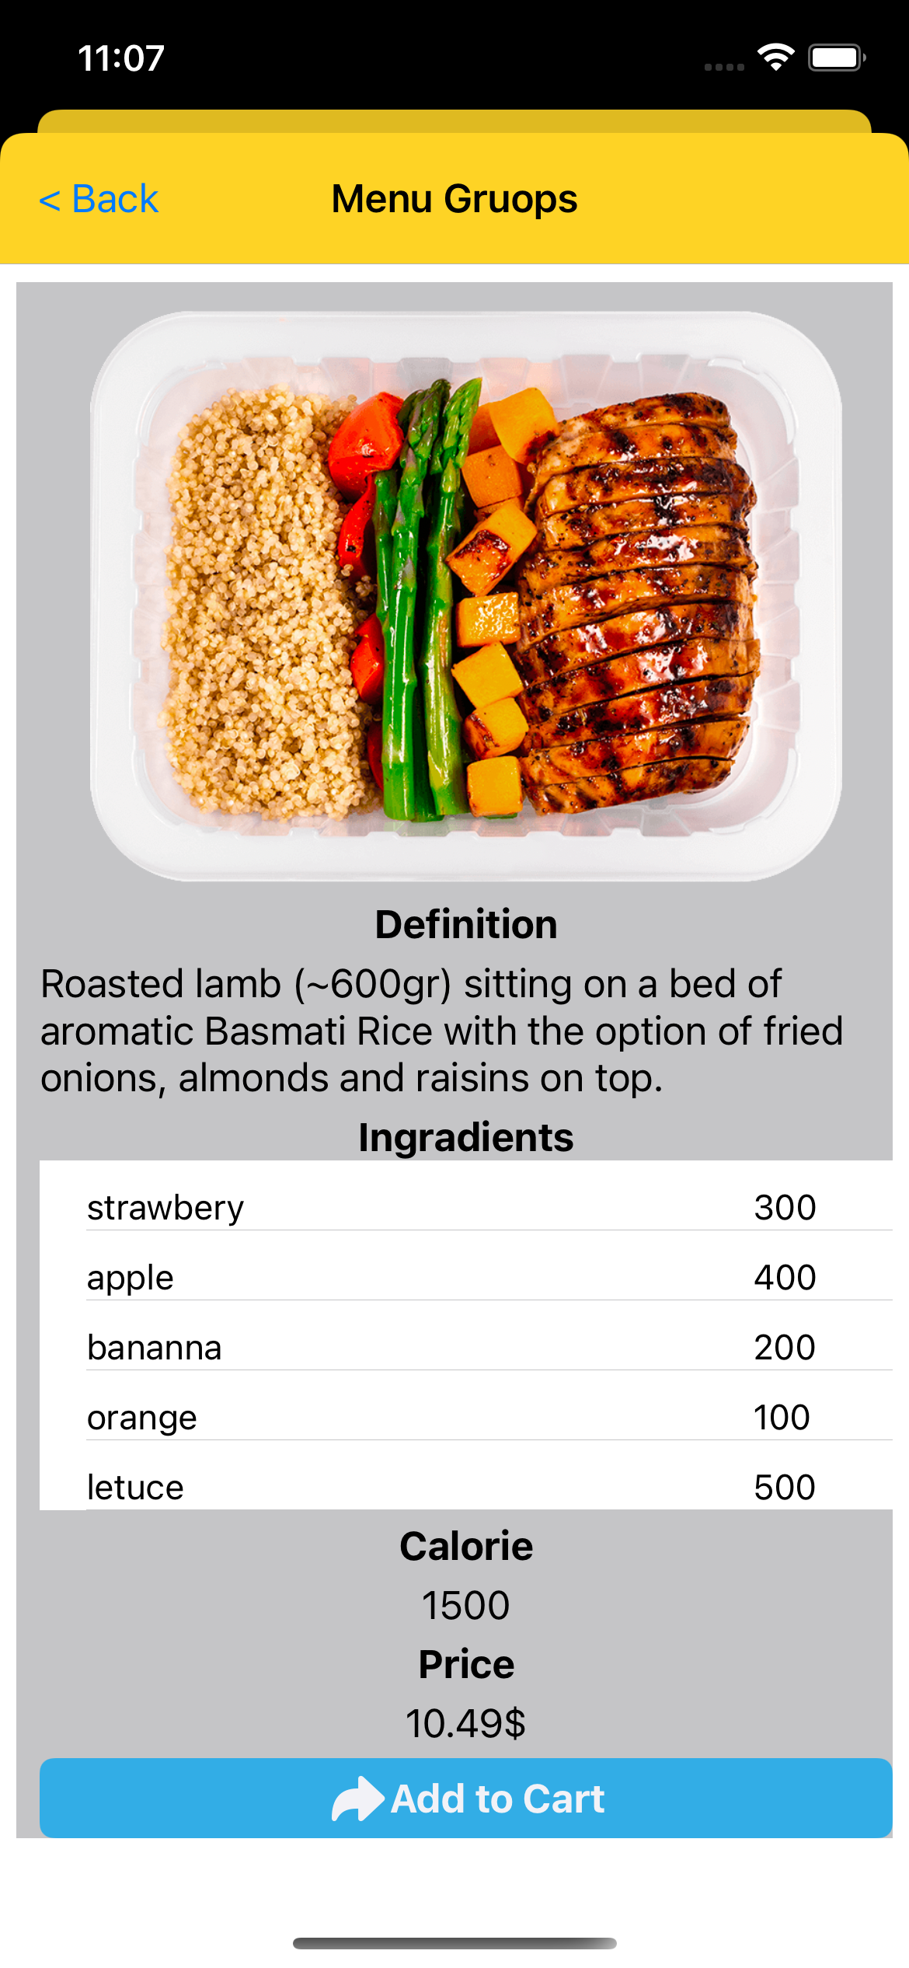
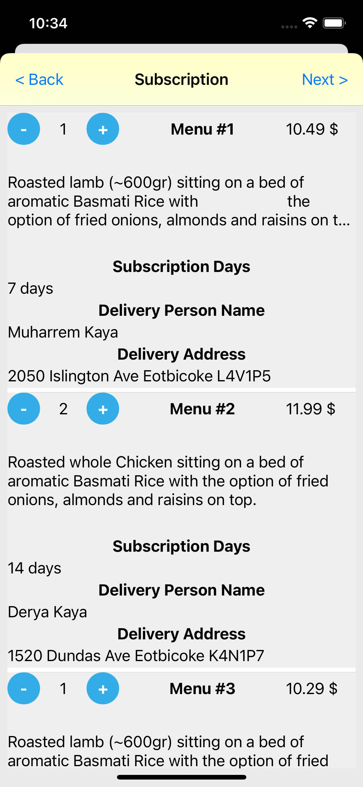
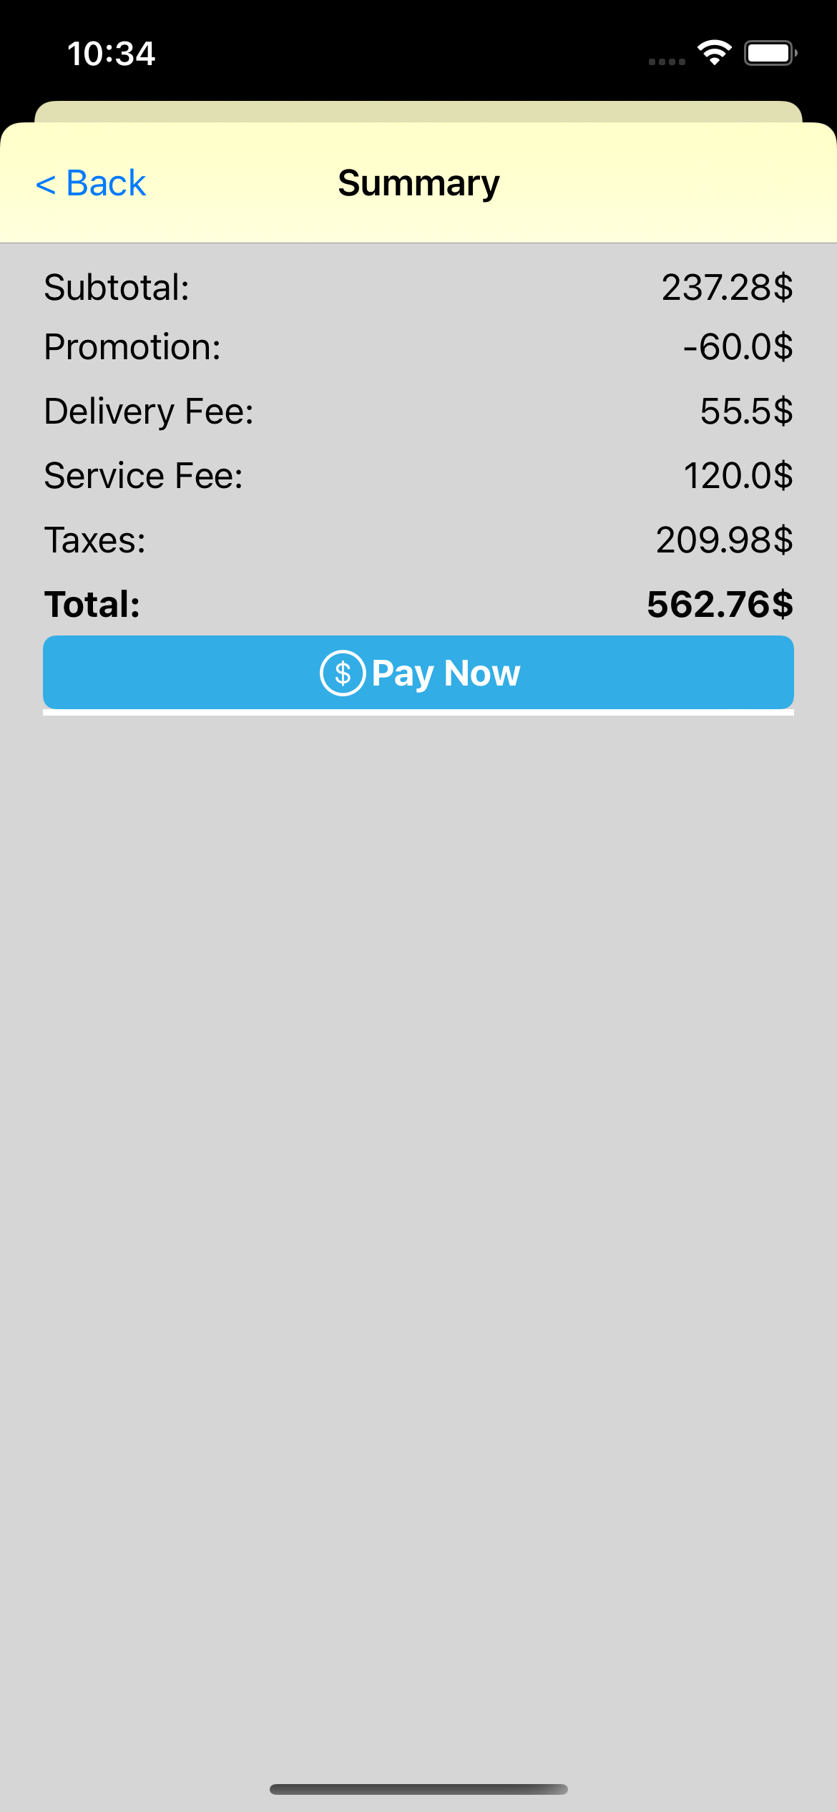
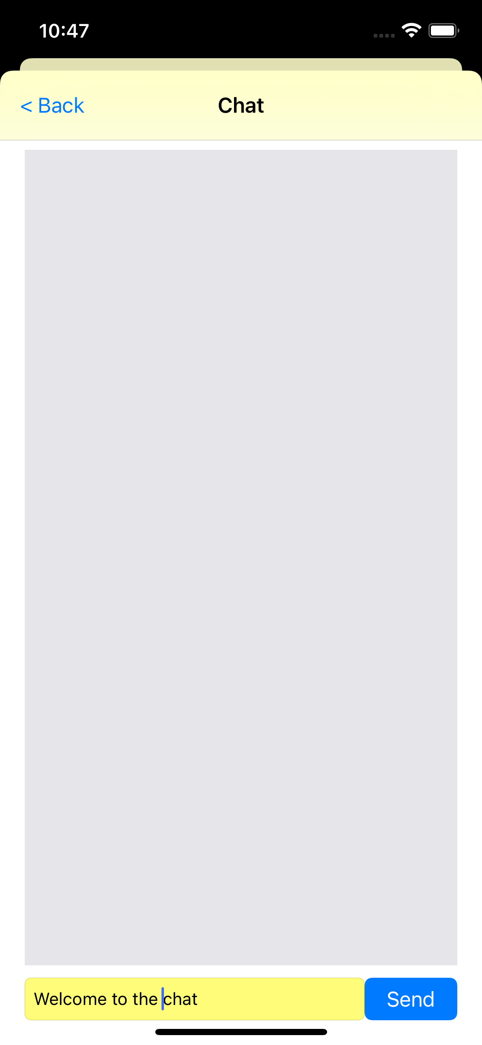
USER INTERFACE - REDESIGN
Menu
Subscription and Payment
Chat

Slide 31
06
FUTURE IMPLEMENTATION

Slide 32
OUR GAME PLAN
SEMESTER 5 (END)
SEMESTER 6 (START)
SEMSETER 5 (START)
SUMMER
SEMESTER 6 (FINAL)
Challenges faced, built UI, backend and added key features
Focus on UX, complete any unfinished task and Test/ iterate project
Create additional features,
adding Kitchen & Transport, connecting back-end to front-end, & design menu with nutritionist
Finalizing a project, split the project
Prepare for
final showcase

Slide 33
THANK YOU
HEALTHY MEAL SERVICE

